Slide 1
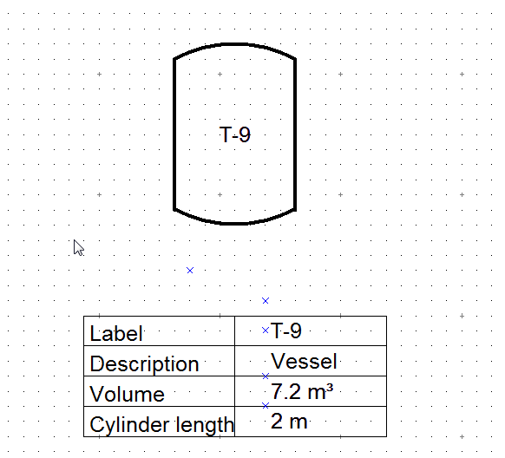
E09 – Tank with equipment box
Schumacher/SAG
Frei verwendbar

